Slide 1




GUVI - Naan Mudhalvan
Engineering Hackathon 2025
www.guvi.in

Slide 2
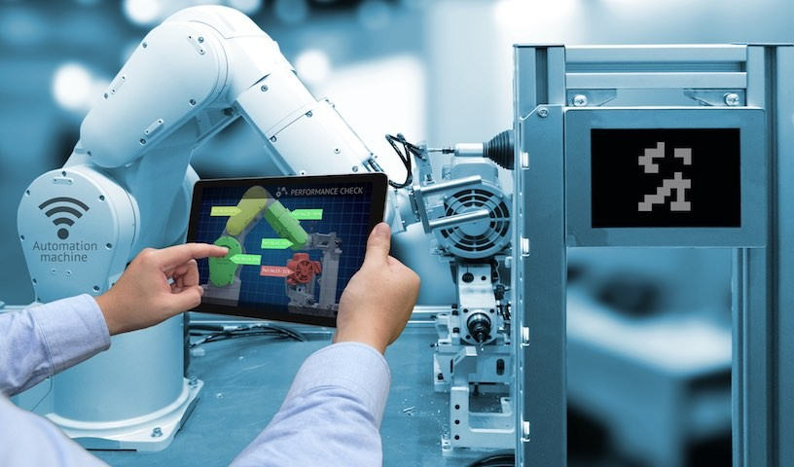
PROBLEM STATEMENT :
Predictive Maintenance of Rotating Machinery Using Sensor Data and Machine Learning Pro
TEAM BLAZE ams
www.guvi.in

Slide 3

DATA DESCRIPTION:
1. Historical Sensor Data:
Vibration level
Temperature
Pressure
Machine runtime hours
Maintenance history
Learning Programs
www.guvi.in

Slide 4
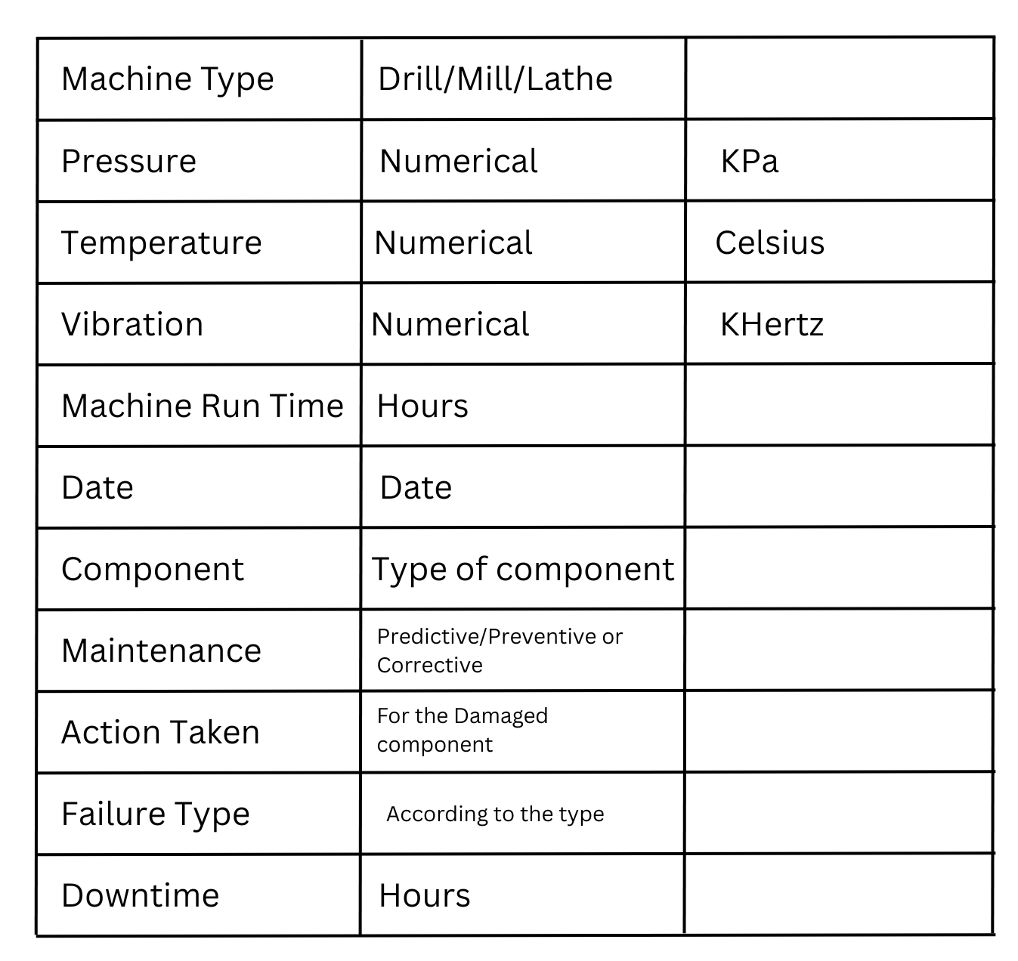
Data-type and units:
Learning Programs
www.guvi.in

Slide 5
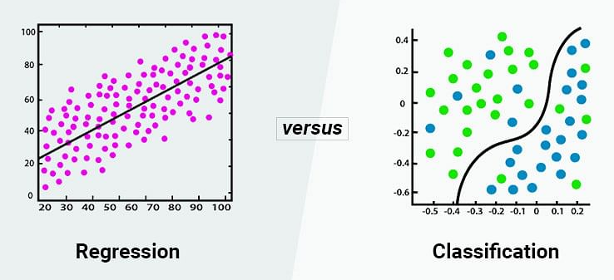
Model Selection & Justification:
Models used :
RandomForest Regresssor
Logistic Regression
IsolationForest – Anomaly Detection
grams
www.guvi.in

Slide 6
Predicts probability of failure based on historical sensor data.
Predicts a binary outcome like 0 or 1
Predicts unusual behavior or rare sensor patterns that may indicate early signs of failure.
arning Programs
www.guvi.in

Slide 7
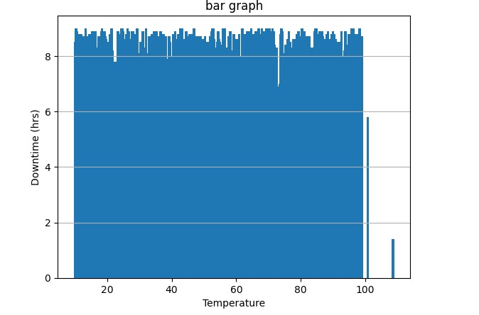
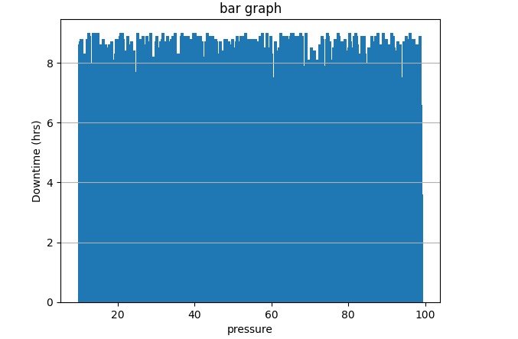
Result Dashboard :r
o
RESULT(downtime in hours):
RandomForest - 4.257
Logistic – 1 ( score- 56.6%)
IsolationForest – 4.257
www.guvi.in

Slide 8
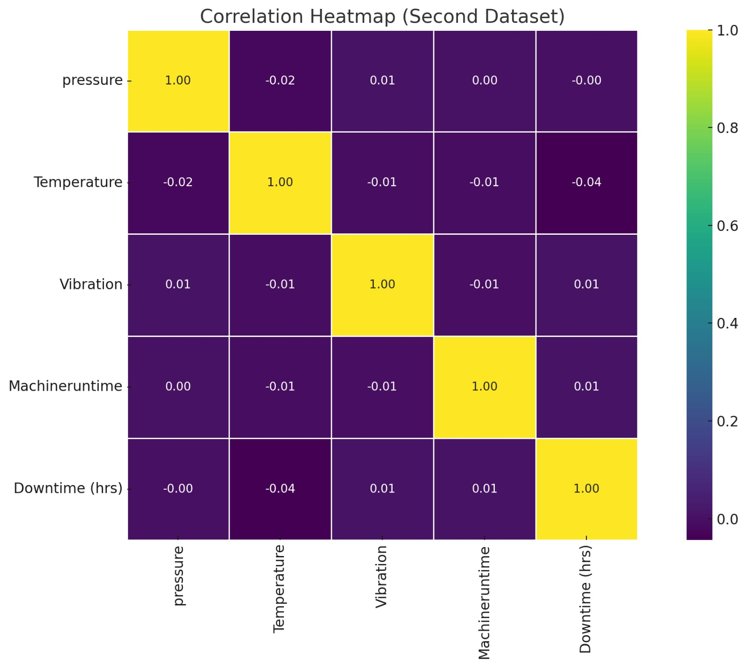
Graph:
Correlation HeatmapPrograms
www.guvi.in

Slide 9

Business Impact:
Lower Maintenance Costs
Extended Lifespan
Reduced Downtime
Improved Safety and Compliance
Increased Efficiency of Machinesni
g Programs
www.guvi.in

Slide 10
Thank You
www.guvi.in

